Slide 1
Modeling Generation and Nonlinear Evolution of VLF Waves for Space Applications
W.A. Scales
Center of Space Science and Engineering Research
Virginia Tech
Collaborators:
L. Rudakov, G. Ganguli, and M. Mithaiwala
Naval Research Laboratory
J. Wang
USC

Slide 2
Outline
Generation of VLF Waves
Motivations and Objectives
Model
Results
Summary
Evolution of VLF Waves
Motivations and Objectives
Model
Results
Ongoing work

Slide 3
Motivation
An ion ring beam in space plasmas can effectively generate VLF waves.
The efficiency of generation of VLF waves may be studied with standard large-scale kinetic (Particle-In-Cell PIC) models.
These models are computationally expensive and dealing with such limitations may lead to compromised estimates in efficiency of the ring beam energy conversion calculation into VLF waves.

Slide 4
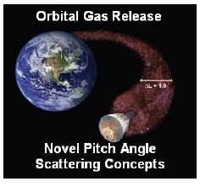
Relevant Application
Velocity Phase Space
10
0
-10
-10
0
10
Release of chemicals such as barium from spacecraft at orbital velocity may generate ring beam plasma capable of generating VLF waves.

Slide 5
Objective
To develop a new more efficient model for better estimating the efficiency of conversion of ring beam energy into VLF wave energy
Phenomenological components of the model:
Localized ring beam initially generates quasi-electrostatic lower hybrid waves
The lower hybrid waves are nonlinearly scattered into electromagnetic whistler/magnetosonic waves
The whistler/magnetosonic waves instantly propagate away from the source region and remove energy from the beam

Slide 6
New Model (hybrid electrostatic)
Ring and background ions treated as Particle-In-Cell PIC
Electrons treated as a fluid with anomalous collisions due to VLF wave convection
perpendicular velocity
parallel
velocity
Anomalous collisions depend on wave amplitude and may be adjusted by parameters ,
is the growth rate of the lower hybrid waves

Slide 7
New Model and Comparison
linear electron density response to potential
corresponding Poisson equation
Another comparison model is to consider the nonlinear terms (particularly inertial) in the electron perpendicular momentum equation but this will not be discussed here.

Slide 8
Simulation Setup
Background plasma set up to replicate ionospheric conditions near 500 km
Ring beam density varied but taken to be equal to background ion density in results. Mass ratio varied between but taken to be 1 here and . The anomalous collisions are varied to study effects.

Slide 9
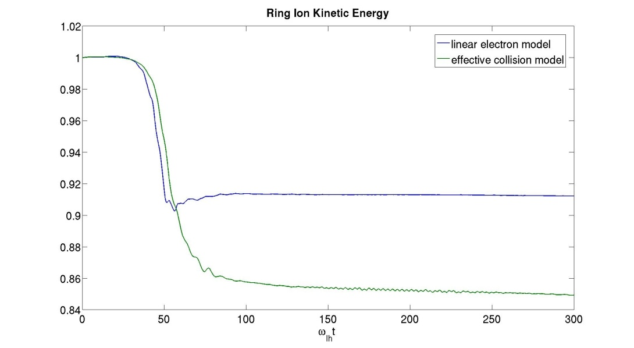
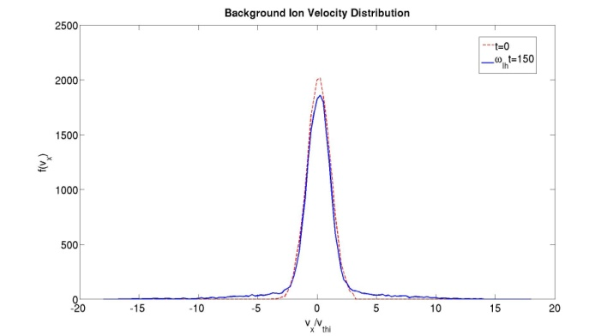
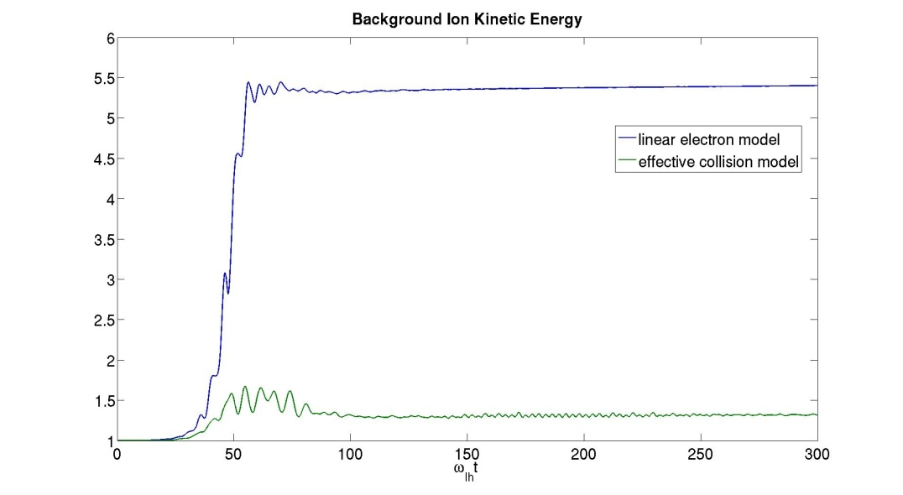
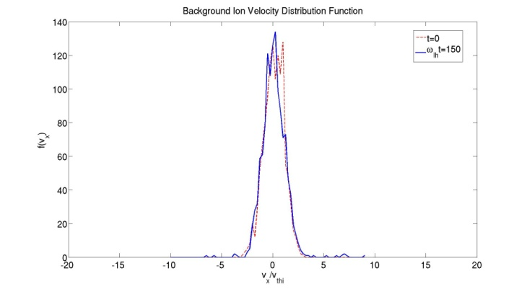
Substantial more energy is released from the ring with effective collisions which model VLF wave convection processes
There is substantially less background ion heating associated
Tail heating is present without effective collisions on the ion distribution function
Ring Ion Kinetic Energy
energy reabsorption (e.g. Kalygin et al., 1971)
velocity distribution
Background Ion Kinetic Energy
tail heating
negligible tail heating

Slide 10
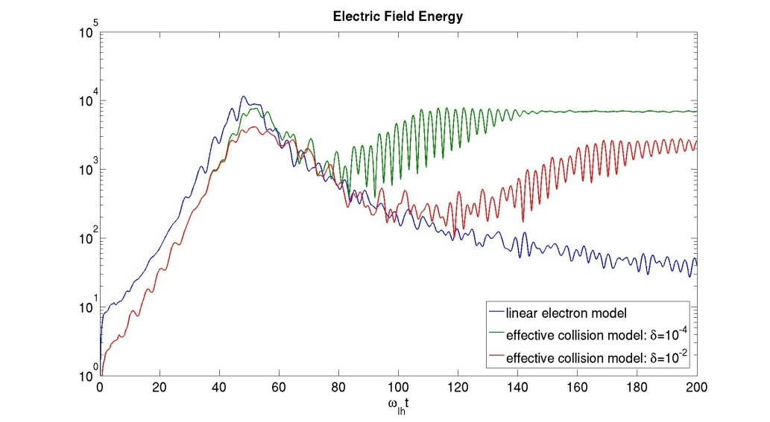
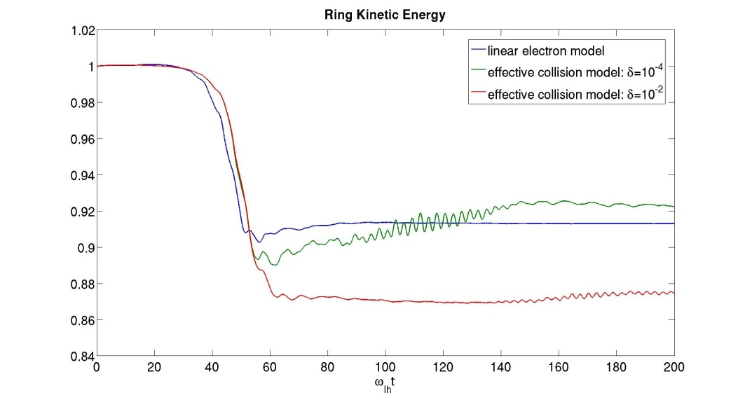
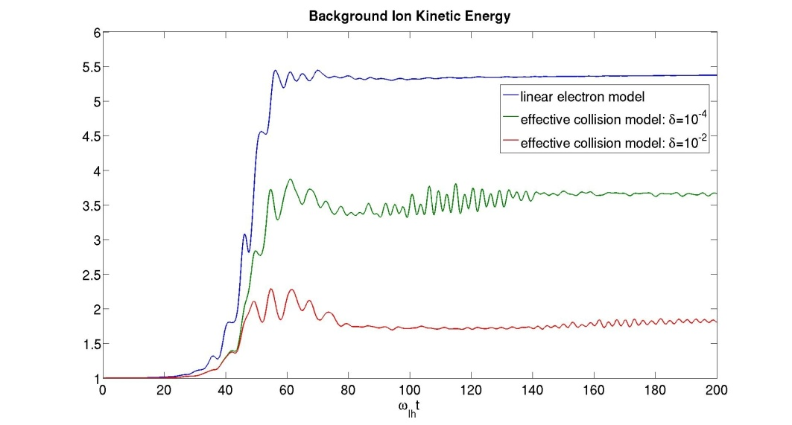
Electric Field Energy
Ring Ion Kinetic Energy
Increasing effective collisions initially allows more release of energy from the ring
Increasing effective collisions reduces background ion heating
It is noted that an optimal effective collision value exists where a maximum amount of energy can be extracted from the ring particles
Background Ion Kinetic Energy

Slide 11
Summary
A new electrostatic model has been developed for calculation of extraction of energy from ring beam for generation of VLF waves.
The model includes effects of VLF wave convection from the ring source region through anomalous electron collisions.
It predicts significantly increased efficiency of energy extraction from ring beam energy into wave production (15% or more) compared to some previous models and also reduction of background ion heating.
The results are more consistent with much more computationally expensive full EM PIC calculations (e.g. McClements et al. 1993).

Slide 12
Motivation
Propagation models overestimate off magnetic equator plasmaspheric wave field strength by 20 dB due to ground-based VLF transmitters (e.g. Starks et al. 2008)
Missing physics that may be attributed to such overestimates include:
Mode conversion (e.g. Eliassaon and Papadopoulos, 2008)
(Nonlinear) scattering (e.g. Ganguli et al., 2010)
Enhanced reflection

Slide 13
Objectives
Model physical processes that lead to conversion of whistler wave energy into lower hybrid wave energy using an electromagnetic particle-in-cell PIC model.
Perform energy budget calculation of this process for the conversion efficiency to assess the contributions to the ‘20 dB problem’.
The first physical process being addressed is nonlinear scattering of whistlers into lower hybrid/magnetosonic waves (Ganguli et al. 2010) and initial extensions of this model framework.

Slide 14
Model
The simulation domain ( X-Y ) is 51.2 and 25.6 electron inertial lengths and θ is the angle between B_{o} and X direction.
Three Cases:
.

Slide 15
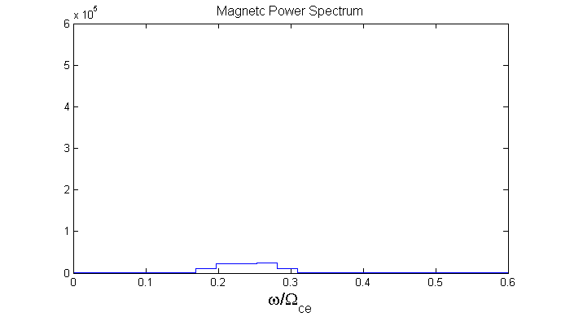
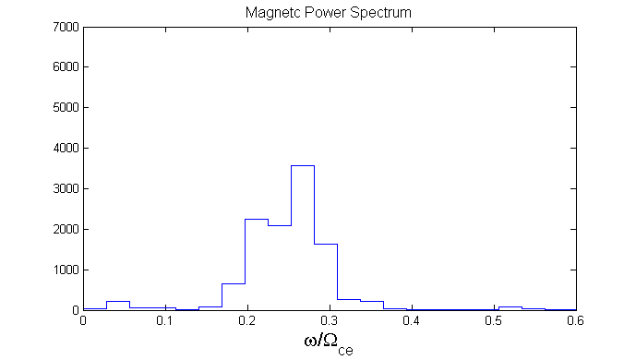
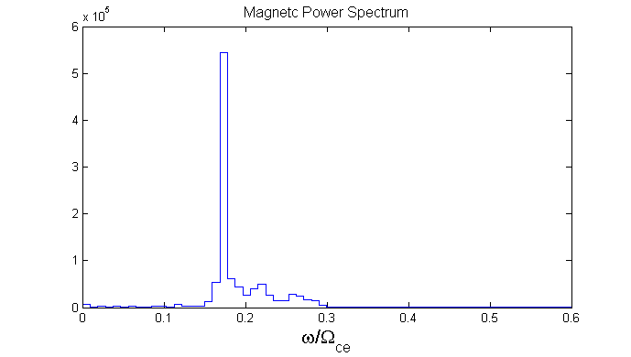
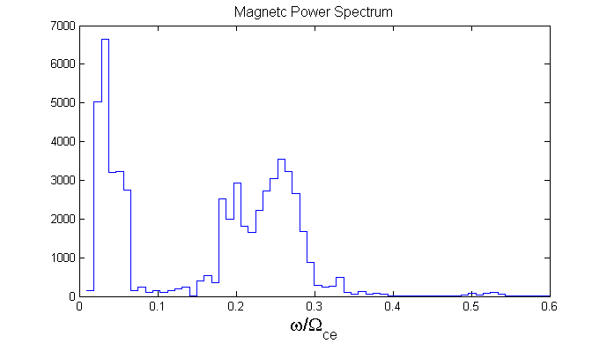
Frequency Power Spectrum
mother whistler wave
whistler waves
0<Ω_{ce}t<200
LH/MS waves
mother/daughter whistler waves
whistler waves
0<Ω_{ce}t<650
For the case with inclination, whistler waves nonlinearly scatter into lower hybrid/magnetosonic waves (Ganguli et al. 2010)
This may provide one avenue for channeling whistler energy into lower hybrid energy.

Slide 16
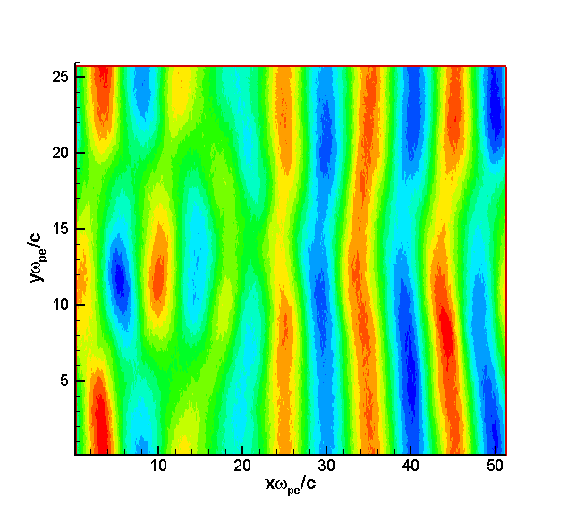
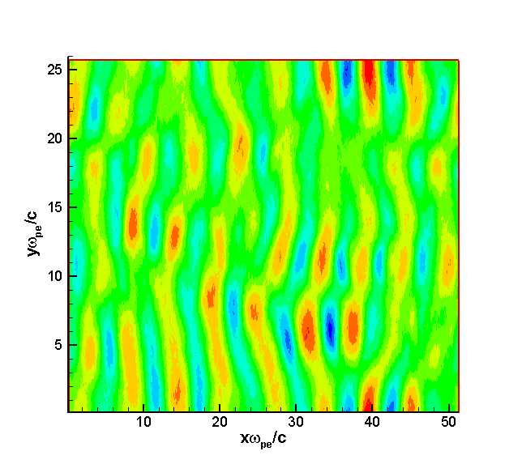
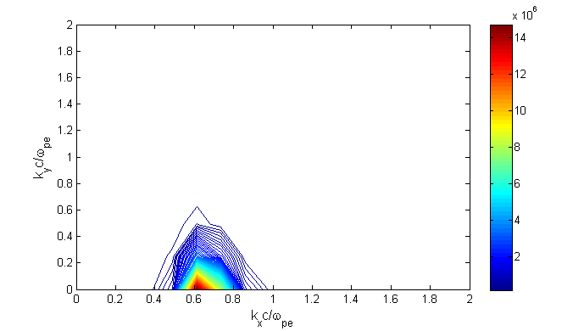
Wavenumber Power Spectrum
(Ω_{ce}t=150)
whistler waves
whistler waves

Slide 17
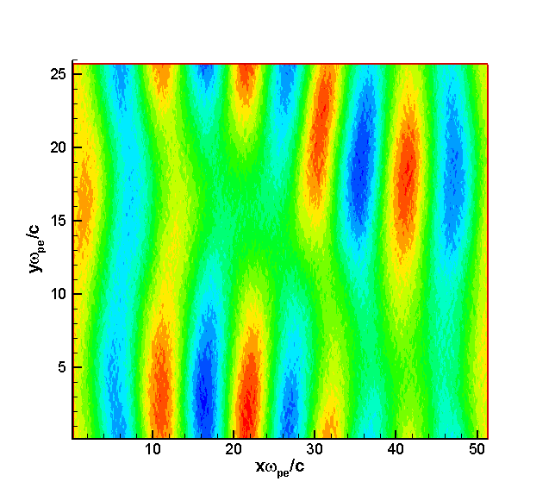
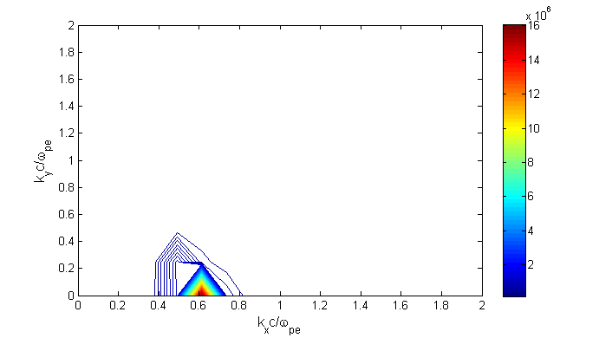
Wave Number Power Spectrum
(Ω_{ce}t=300)
LH/MS
daughter
whistler mother
whistler waves
whistler daughter
Nonlinear scattering of the whistler waves is evident with inclined B₀ and is a characteristic of the nonlinear evolution of 3D whistler turbulence.

Slide 18
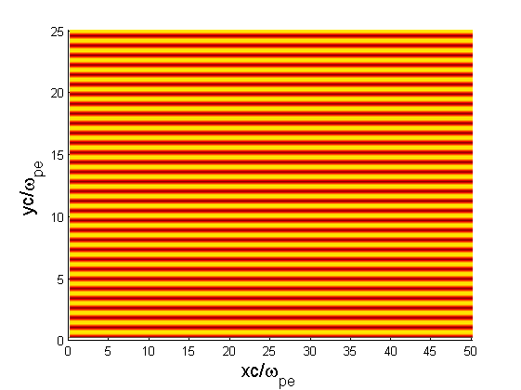
Often space plasmas are preconditioned with density structures which may allow conversion between whistlers and lower hybrid waves.
This has been considered by a number of investigators.
Initial attempts to consider impact of field-aligned density striations within the framework of the model were considered.
No nonlinear scattering between whistlers to lower hybrid waves is observed at so this is the configuration considered first.

Slide 19
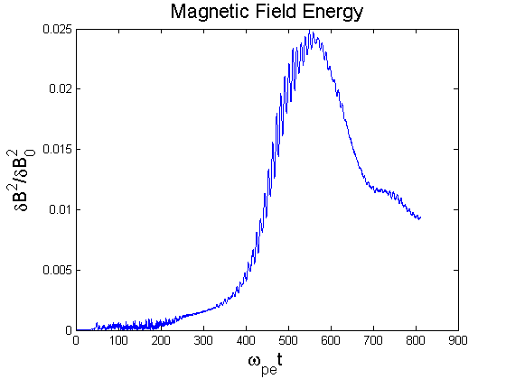
Evolution typically shows initial development of whistlers and subsequent development of much larger amplitude lower hybrid waves.
This typically occurs for striation of
for parameters considered.*
Initial whistler growth by simulation ring source
* limitations may be linked to number of particles per cell in current simulations

Slide 20
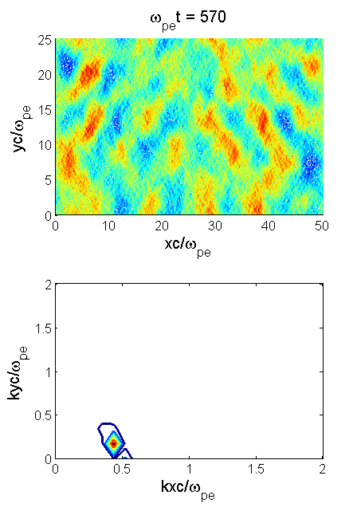
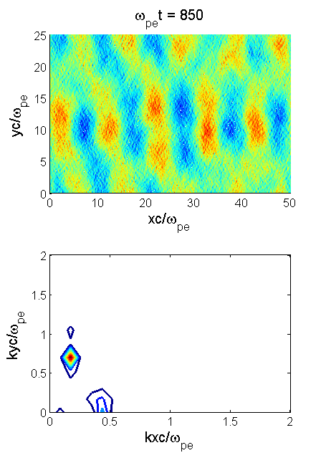
LH
whistler
whistler
The wavenumber spectrum now exhibits both whistler and LH waves at later times unlike the case with no striations and .
Whistler wave energy is converted into LH wave energy (and visa versa)
This is expected to be linear mode conversion (e.g. Eliasson and Papadopoulos, 2008)

Slide 21
Summary/Ongoing Work
Both nonlinear scattering of whistlers into lower hybrid waves and linear mode conversion are viable explanations for the 20 dB puzzle associated with ground-based VLF transmissions.
A model framework has been discussed that may be used to investigate physical processes associated with both has been discussed.
On going work is considering energy budget calculations associated with each process as well as incorporation of other relevant plasma density structures.

