Slide 1

Radiation Belt Modeling and
Wave-Particle Interactions
DISTRIBUTION D: Distribution authorized to Department of Defense and DoD contractors (Administrative or Operational Use); 10 Dec 2010. Other requests for this document shall be referred to Air Force Research Laboratory/RVBX, 3550 Aberdeen Ave SE, Kirtland AFB, NM 87117-5776.
Michael J. Starks
Space Vehicles Directorate
Air Force Research Laboratory

Slide 2
Outline
  Radiation Belt Dynamics
  Wave-Particle Interactions
  Radiation Belt Modeling
  Terrestrial VLF Transmitters
  Space VLF Transmitters
  Lightning
  Summary

Slide 3
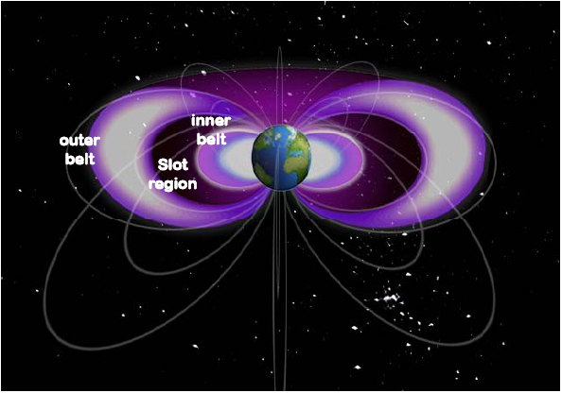
Radiation Belts
  The Earth’s radiation belts are variable but robust. Energetic electrons are stably trapped by the Earth’s magnetic field. These electrons pose substantial hazards to spacecraft.

Slide 4
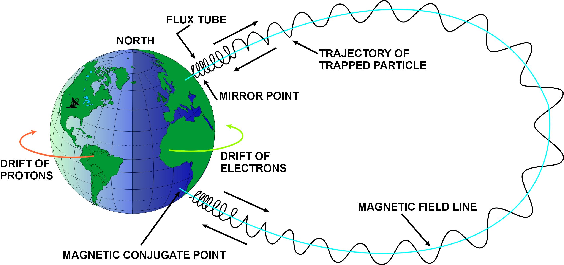
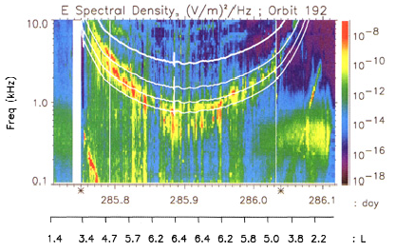
Wave-Particle Interactions
Particles mirroring below
100 km are “lost”
Particle pitch-angle
ELF/VLF Waves Control Particle Lifetimes
Electromagnetic
waves
L shell = distance/R_{E}
Electromagnetic waves in the Very Low Frequency (VLF) range (3-30 kHz) scatter and accelerate radiation belt electrons through cyclotron resonance interactions
Waves from CRRES (1990)

Slide 5
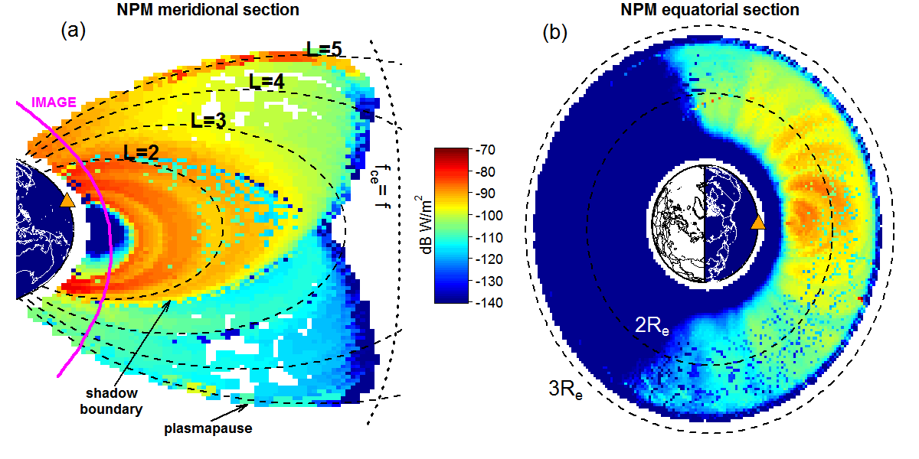
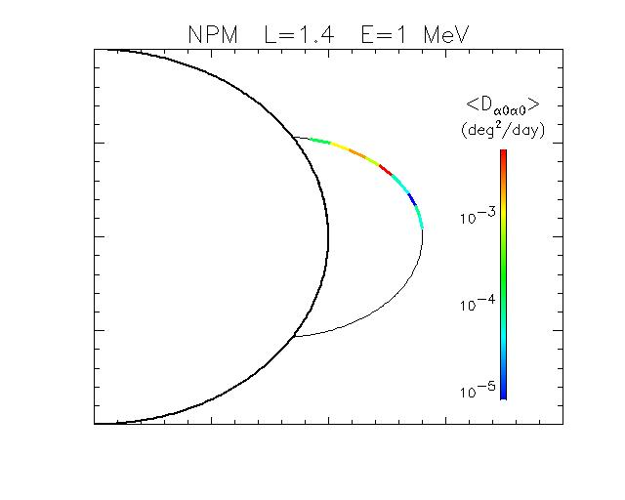


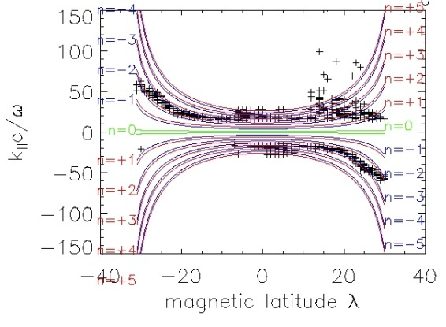
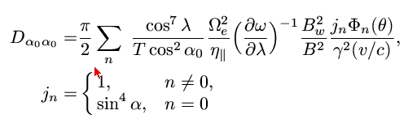
Radiation Belt Modeling
Transmitters
Diffusion coefficient along field lines
Particle lifetime along field lines
(approximate 1D solution)
Natural VLF
Wave power in the magnetosphere
Diffusion coefficients
along field lines
Full 3D global, time dependent particle distributions
X_{i} = (L, E, α )
Distribution of Resonant Wave Vectors
Quantitative maps of ELF-VLF wave power distribution are crucial for radiation belt specification & forecasting
Wave-particle resonance condition
Diffusion coefficients = sum over resonances
Complex dependence on energy, frequency, and pitch angle

Slide 6
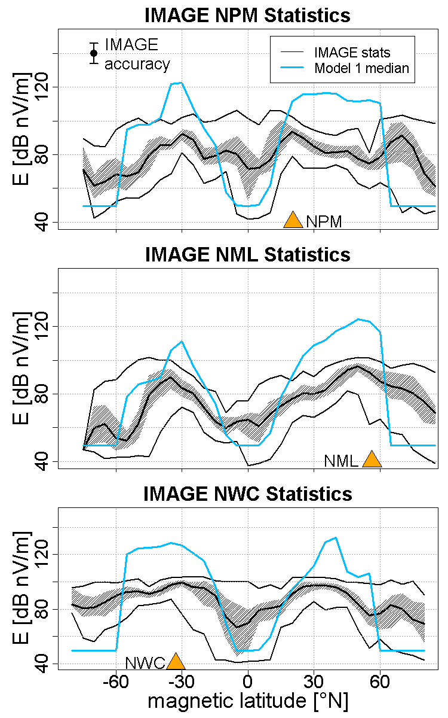
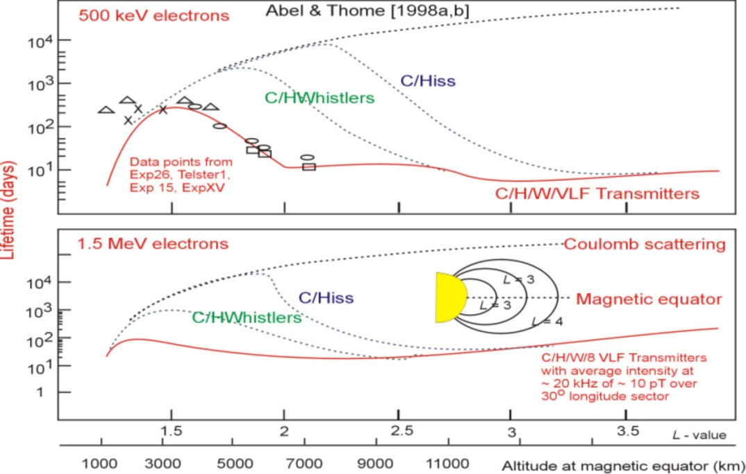
Terrestrial Transmitters
The 20 dB Problem
Abel & Thorne (1998)
Starks, et al. (2008)
≠
Ground transmitter VLF needed in the inner magnetosphere… but where is it?
Could lightning be more effective than previously thought?

Slide 7
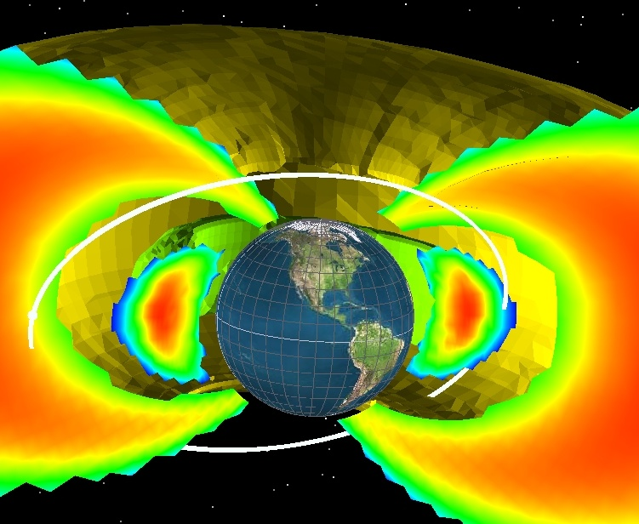
The DSX Mission
Apogee (altitude in km) | 12,000
Perigee (altitude in km) | 6,000
Inclination (degs) | 120
Argument of perigee (degs) | 357.9 (90)
Right ascension of the ascending node (degs) | TBD (90)
True anomaly (degs) | TBD (180)
Start time (UT) | 12:00:00 01 Oct 2012
Period (hours) | 5.277

Slide 8
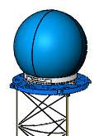
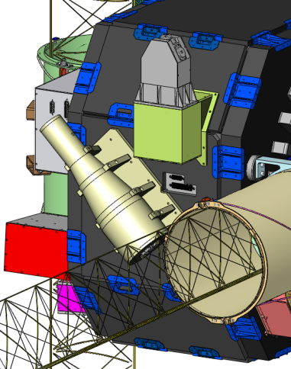

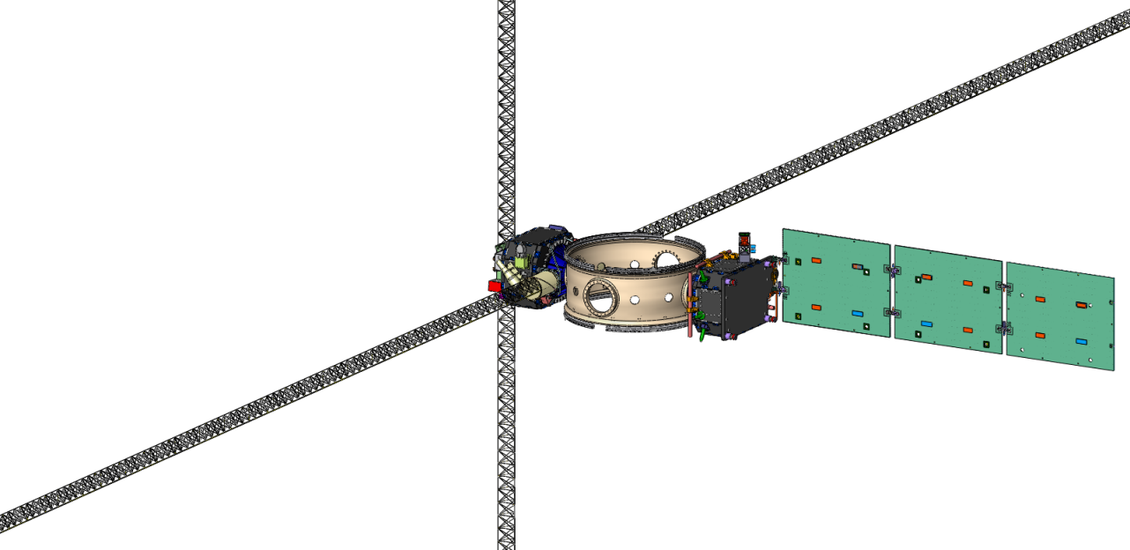
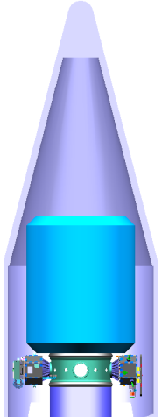

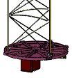
The DSX Satellite
Wave-Particle Interactions (WPIx)
  VLF transmitter & receivers
  Loss cone imager
  Vector magnetometer
Space Weather (SWx)
  5 particle & plasma detectors
Space Environmental Effects (SFx)
  NASA Space Environment Testbed
  AFRL effects experiment
AC Magnetometer
  Tri-axial search coils
FSH
Z-Axis Booms
VLF E-field Rx
HST
ESPA Ring
  Interfaces between EELV & satellite
Loss Cone Imager
- High Sensitivity Telescope
- Fixed Sensor Head
VLF Transmitter & Receivers
  Broadband receiver
  Transmitter & tuning unit
Y-Axis Booms
VLF E-field Tx/Rx
DC Vector Magnetometer
Notes:
Mention the various payload contractors

Slide 9
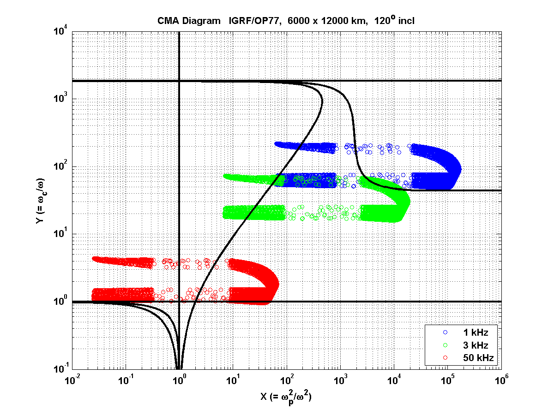
Cold Plasma Regime
Where is DSX?
m_{i}/m_{e}
L
L
R
R
R
X
O
X
X
S=0
L=0
R
Vacuum limit
R
L
O
X

Slide 10
Antenna Modeling
Vacuum
Linear cold plasma – current distribution on antenna specified
Linear cold plasma – voltage on antenna specified, current distribution on antenna calculated consistently
Sheath& plasma heating effects included

Slide 11
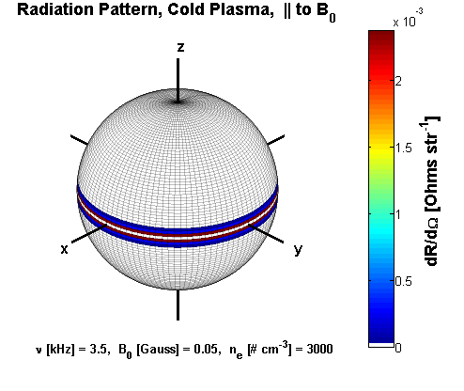
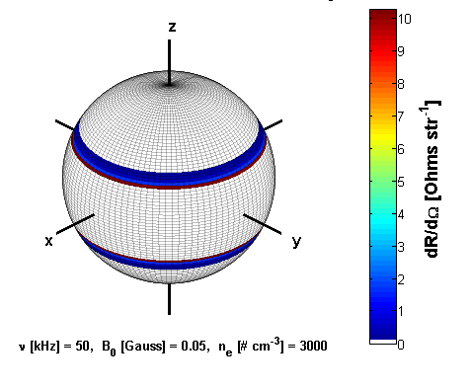
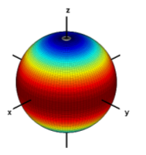
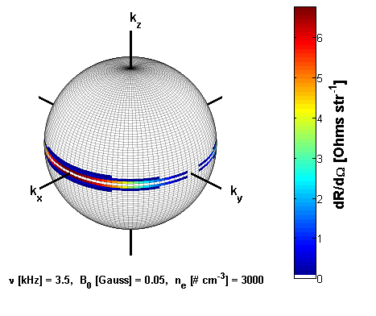
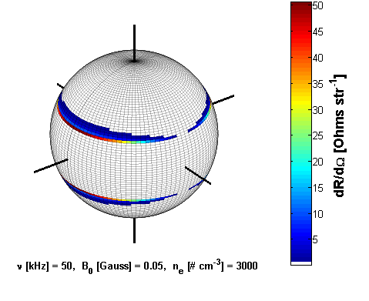
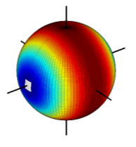
Linear Cold Plasma
Radiation Patterns
3.5 kHz
50 kHz
z
B
antenna
x
y
Parallel
vacuum
z
B
antenna
x
y
Perpendicular
vacuum
θ_{c} = 89.4° – 68.3°, ν = 3.2 kHz (LH resonance) – 50 kHz

Slide 12
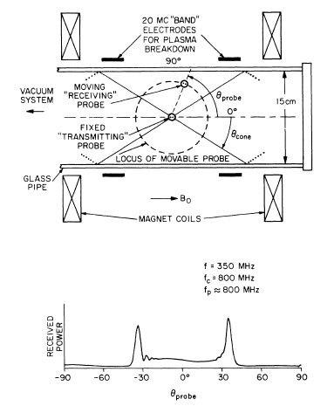
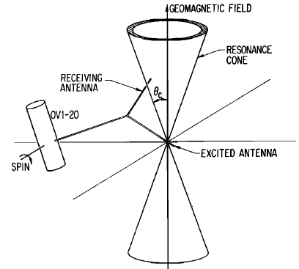
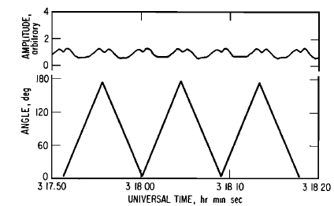
Evidence for Resonance Cones
In the laboratory
In space
B₀
B₀
Resonance cones
Resonance cones
Fisher and Gould, Resonance Cones in the Field Pattern of a Short Antenna in an Anisotropic Plasma, Phys. Rev. Lett., 22, 1092-1095, 1969.
Koons, et al., Oblique resonances excited in the near field of a satellite-borne electric dipole antenna, Radio Sci., 9, 541-545, 1974.

Slide 13
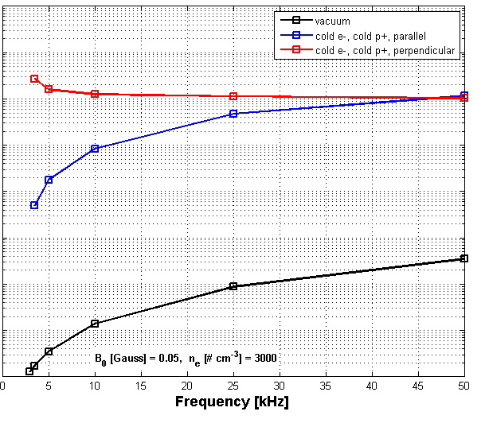
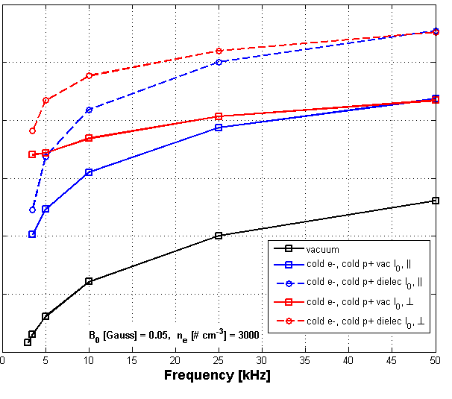
UNCLASSIFIED
Radiated Power Computations
Normalized Radiation Resistance
Normalized Power
8
12
10
6
8
4
6
normalized radiation resistance [log Ohms]
Normalized power [log Watts]
4
2
2
0
0
Vacuum current,
Constant dielectric current,
Cold plasma dielectric current,
????

Slide 14

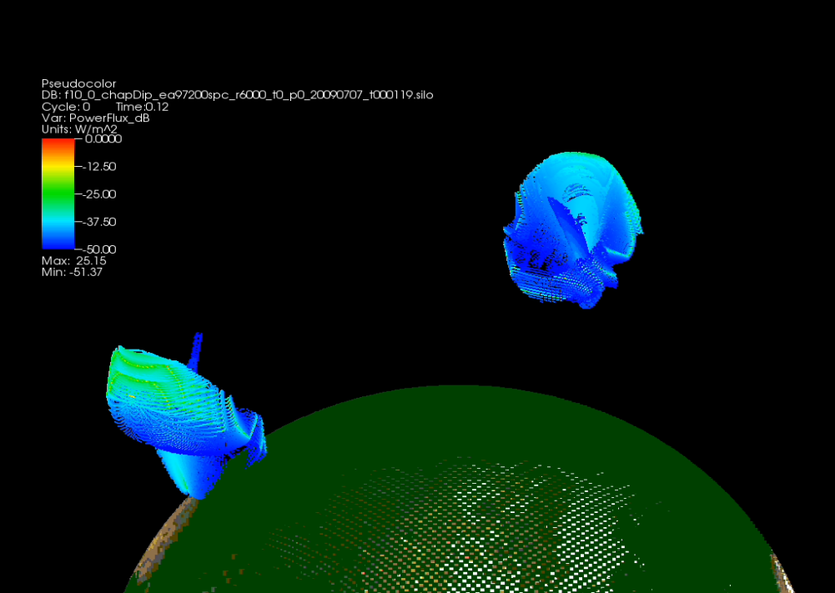
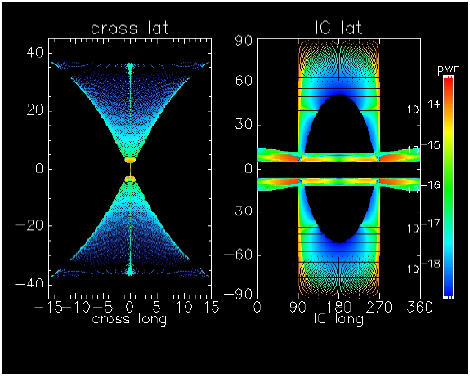
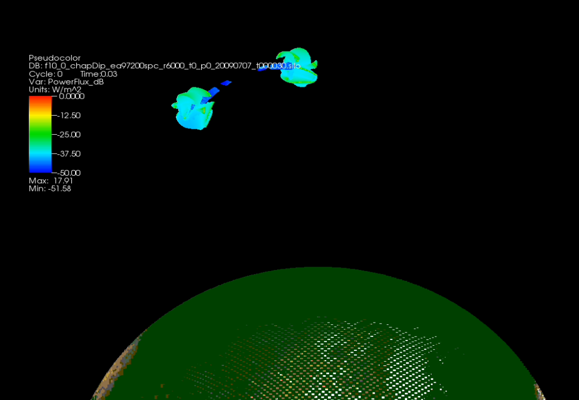
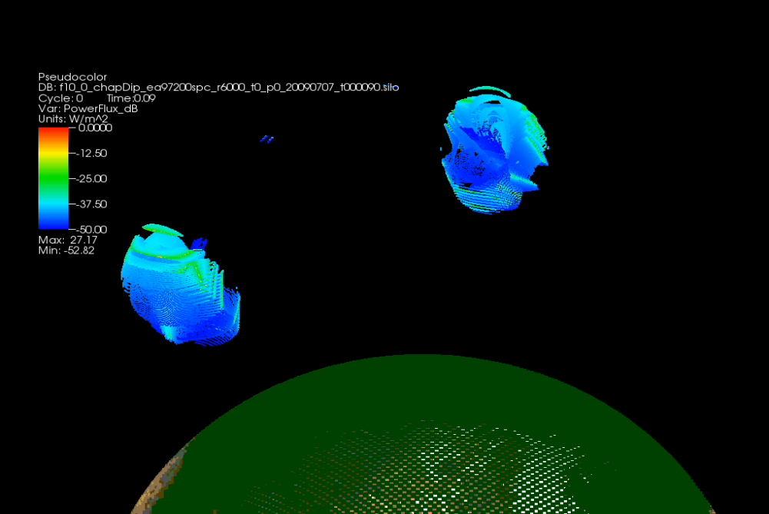
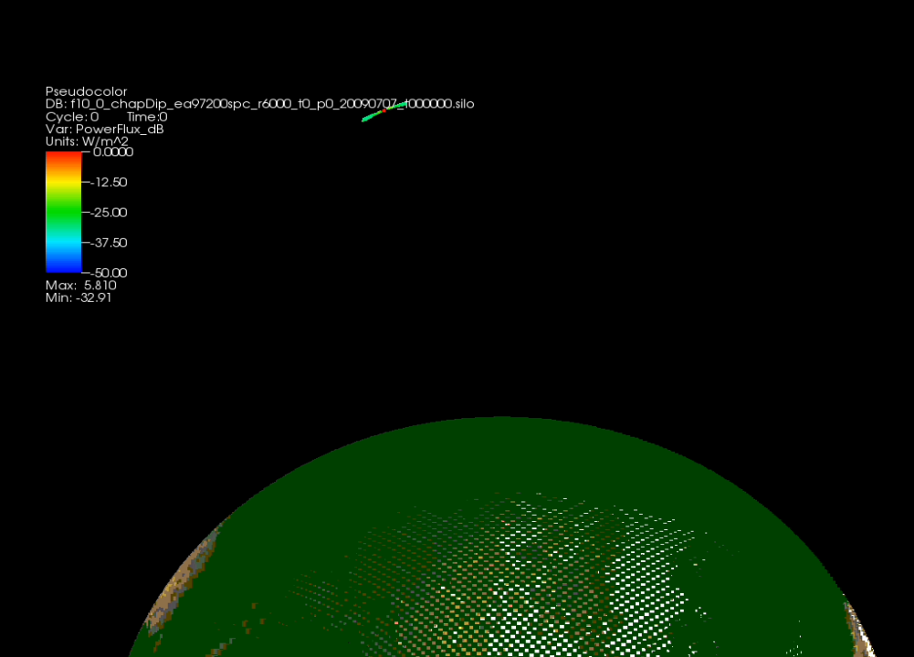
VLF Transmitters in Space
  Space transmitters produce much more complex wave fields than terrestrial transmitters
  The resulting wave field complicates the computation of wave-particle interactions
  AFRL has focused substantial resources on solving these questions in preparation for the DSX mission
Accurate space transmitter models are a prerequisite to understanding the behavior of DSX

Slide 15
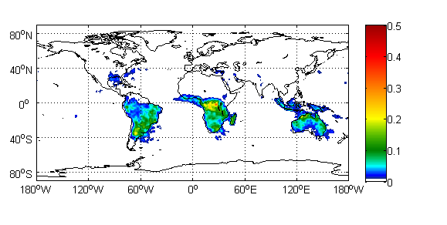
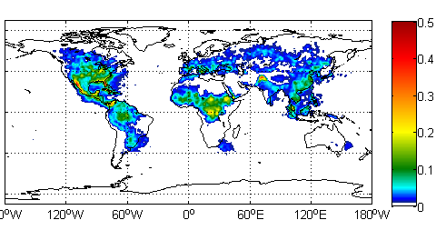
The Role of Lightning in the Inner Magnetosphere
Satellite-Derived (LIS/OTD) Monthly Global Lightning Climatology (1995 – 2003)
Flashes Km⁻² Year
January
August
Lightning couples an enormous amount of VLF energy into the inner magnetosphere, driving radiation belt dynamics
DSX will help to quantify the lightning VLF flux and determine whether it represents the “missing power”

Slide 16
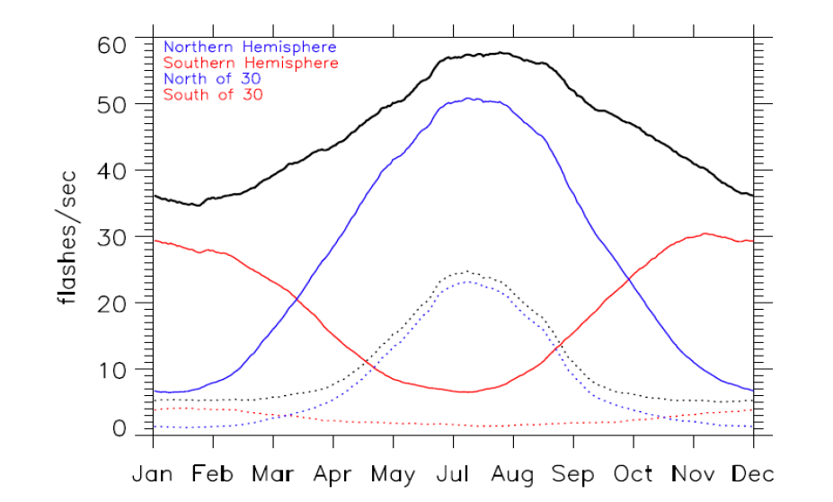
Lightning Contributions
The prevalence of lightning is known, but the coupling of VLF to space is not as well understood

Slide 17
Summary
  Important questions remain regarding radiation belt dynamics
  Some existing models are known to be deficient; others may yet be overturned
  AFRL views carefully validated models as the only route to predictive capabilities
  The balance of power in the inner magnetosphere between terrestrial transmitters, lightning and hiss has been overturned
  Outstanding science questions about each influence need answers

