Slide 1
Artificial emissions and formation of ionized layers in the ionosphere due to HF-heating
G. Milikh(1), D. Papadopoulos(1), B. Eliasson(1), Xi Shao(1),
and E. Mishin(2)
University of MD, College Park
(2) Space Vehicles Directorate, Air Force Research Laboratory

Slide 2
Motivations and Objectives
Models of electron acceleration due to HF-heating were introduced since 1970-es.
However recent optical and ionosonde observations emphasized a need of a comprehensive model of electron acceleration by the Langmuir turbulence due to the ionospheric HF-heating.
The objective of this project is to develop such a model and check it against the existing observations.

Slide 3
Model Approach
Describe topside electrostatic turbulence due to HF-heating
Obtain energy spectrum of the electrons accelerated by such turbulence:
- Solving the F-P equation
- Using PIC method
Consider effects on the energy spectrum due to energy losses by the electrons propagating in the ionosphere
Study effects caused by the fast electrons:
- Optical emissions
- Formation of ionized layers

Slide 4
Simulation of topside ionospheric turbulence [Eliasson, 2008, 2010]
A full scale model of the ionosphere is applied, in which O-mode EM wave, is injected from the bottom side. 1D ionospheric density profile has a Gaussian shape, B-field is tilted 14 deg. to vertical.
The mathematical model includes equations for all three E-field components coupled with electron and ion continuity and momentum 1D equations.

Slide 5
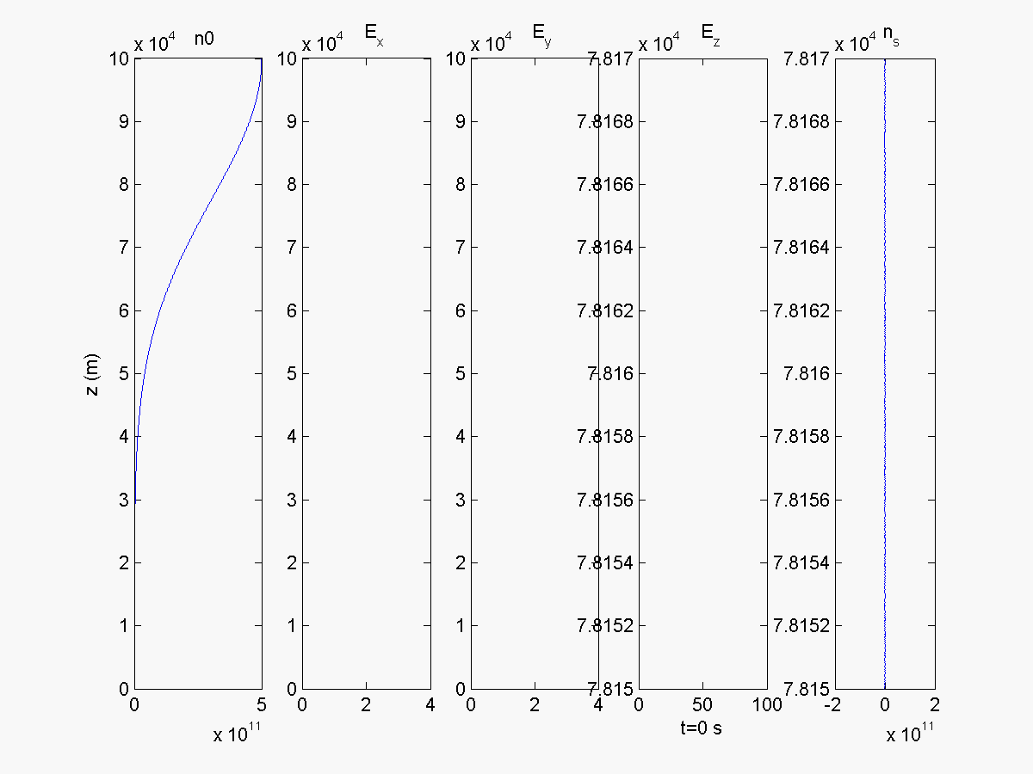

Slide 6
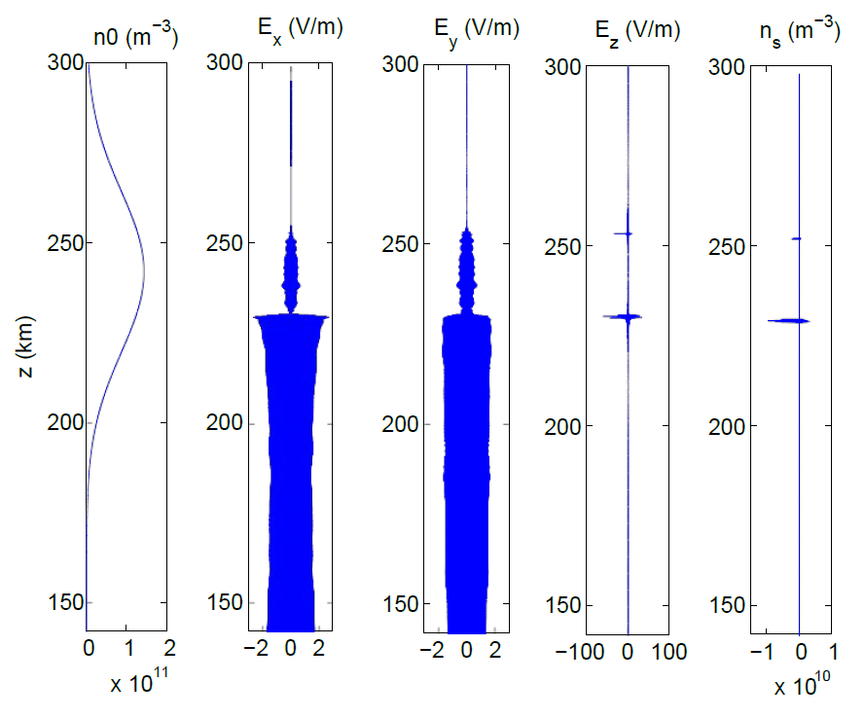
Most notably is the strong Ez field at ~230 km which is associated with electrostatic Langmuir waves that have collapsed into solitary wave packets.

Slide 7
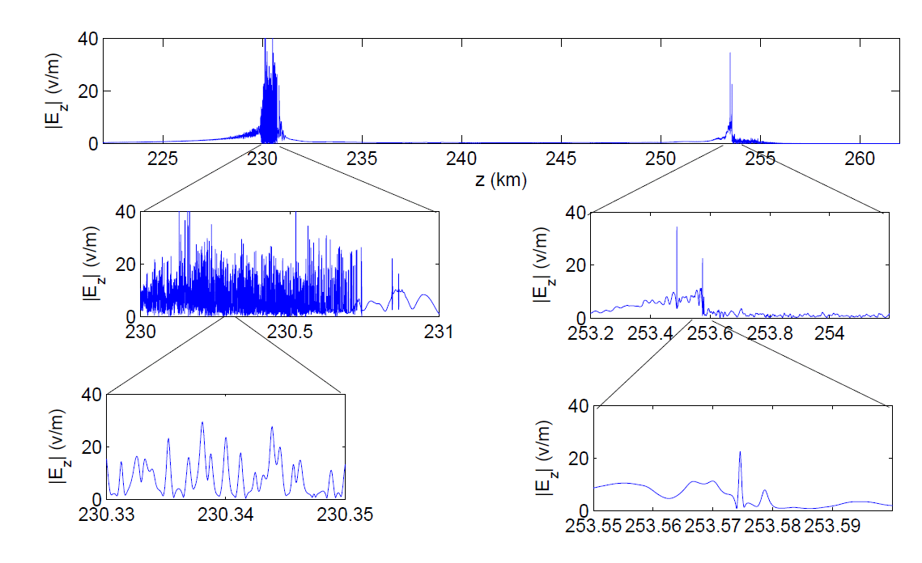
Amplitude of Ez-field at different heights, for injected E0=1.5 V/m, O-mode.

Slide 8
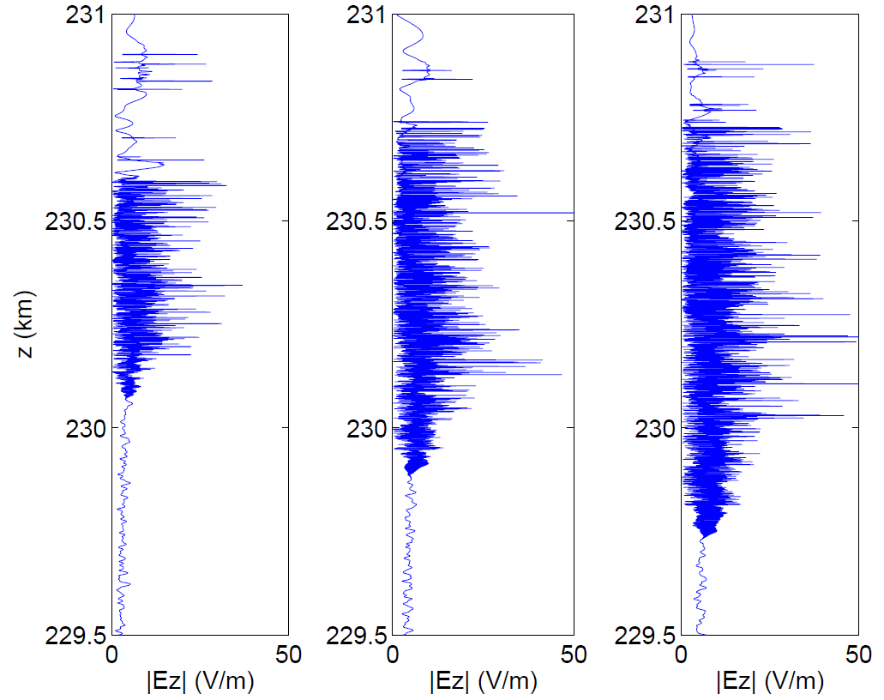
Ez at the vicinity of O-mode cutoff, Injected are the waves of 1.0 V/m, 1.5 V/m and 2.0 V/m.

Slide 9

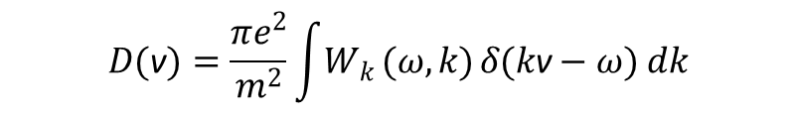
Electron acceleration by quasi-linear diffusion by plasma waves
Slowly varying electron distribution function is governed by F-P equation
$$\frac{∂f}{∂t}+\text{v}\frac{∂f}{∂z}=\frac{∂}{∂\text{v}}D(\text{v})\frac{∂f}{∂\text{v}}$$
$$D(\text{v})=\frac{πe^{2}}{m^{2}}\int{W_{k}}(ω,k) δ(k\text{v}−ω) dk$$
${ W}_{k} \text{i}$s the spectral density of the electric field per wave number

Slide 10
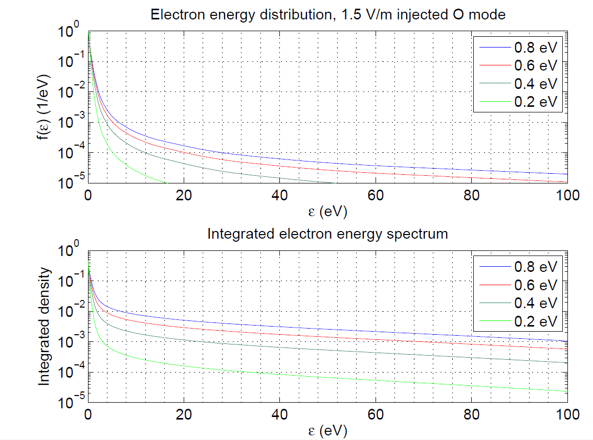
The energy distribution and integrated density.

Slide 11
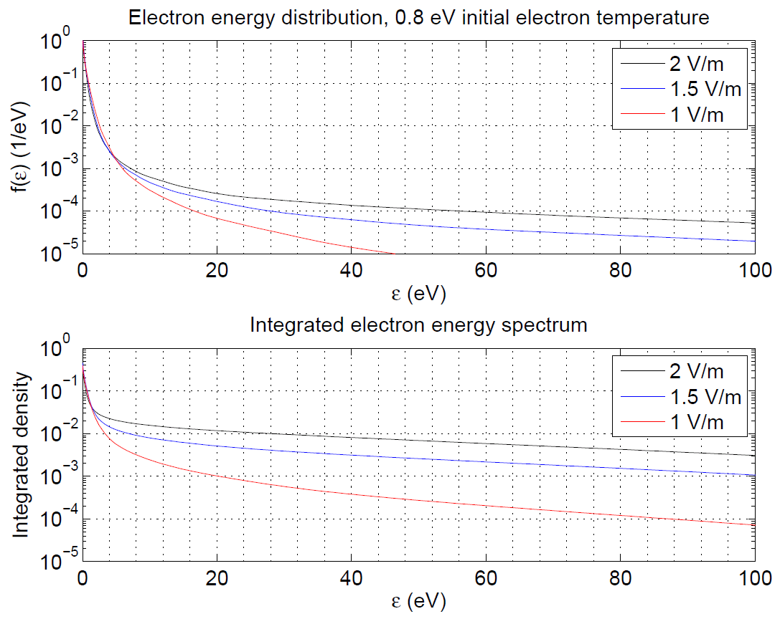
Fig. 20. The energy distribution and integrated density.

Slide 12
Comparing Diffusion Calculation with Particle Tracing
Particle
Tracing
Particle
Tracing
Diffusion
Diffusion
f(E)
f(E)
Initial
Thermal
E₀ = 0.4 eV
Initial
Thermal
E₀ = 0.6 eV
E (eV)
E (eV)
Particle
Tracing
Diffusion
f(E)
Initial
Thermal
E₀ = 1.0 eV

Slide 13
Modeling Flux Transport
Gurevich et al. [1985] showed that propagation of fast electrons outside of accelerating layer is described by the kinetic equation:

Slide 14
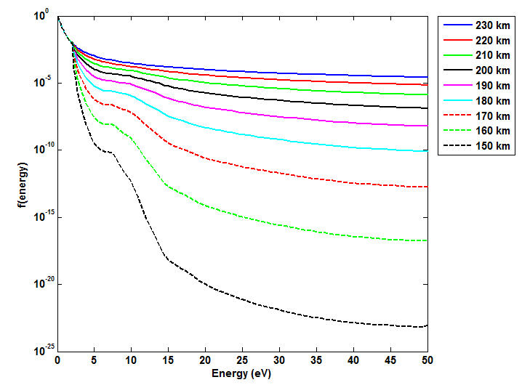
E = 1.5 V/m, Simulation for HAARP, E0 = 0.6 eV, Z0= 230 km, O Mode: f(E) for z= 150-230km

Slide 15
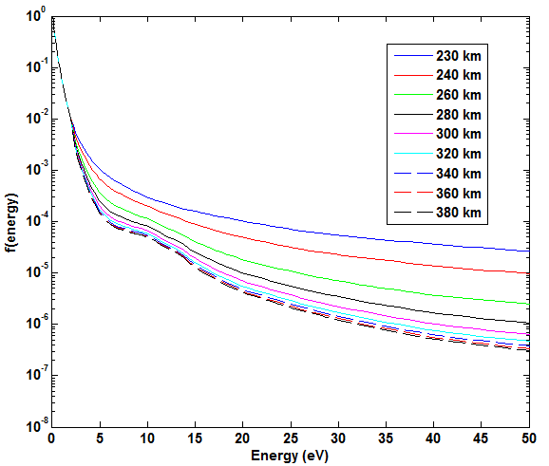
E = 1.5 V/m, Simulation for HAARP, E0 = 0.6 eV, Z0= 230 km, O Mode: f(E) for z= 230-380 km

Slide 16
Optical emissions
Electronic Level | Emission, nm | Threshold, eV | Misc.
 | 630 | 1.96 | Red line
 | 557.7 | 4.19 | Green line
 | 777.4 | 10.74
 | 844.6 | 10.99
 | 2,531-478 | 7.35 | 1P (645.4 nm band (8,5))
 | 587-286 | 18.8 | 1N (391.4 nm band (0,0))

Slide 17
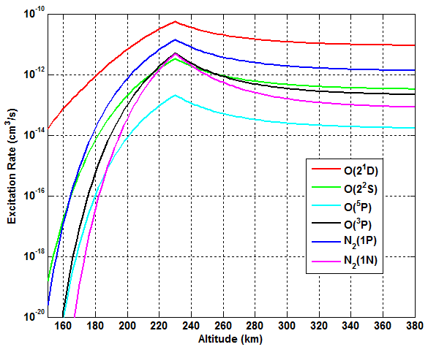
Modeling Optical Emission: Excitation Rate (E = 1.5 V/m, Simulation for HAARP, E0 = 0.6 eV, Z0= 230 km, O Mode)

Slide 18
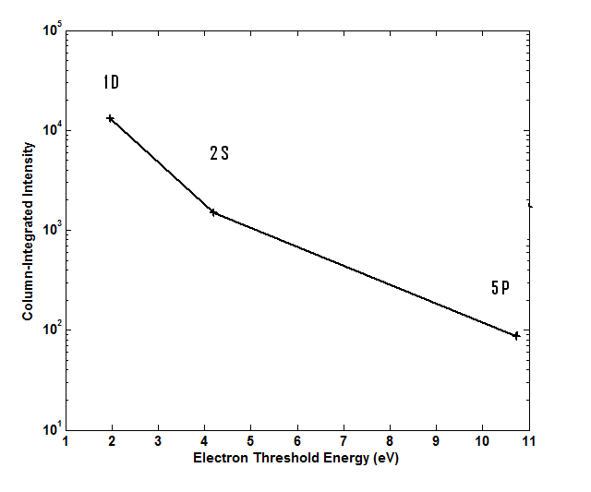
Model of the column integrated optical emissions of atomic oxygen

Slide 19
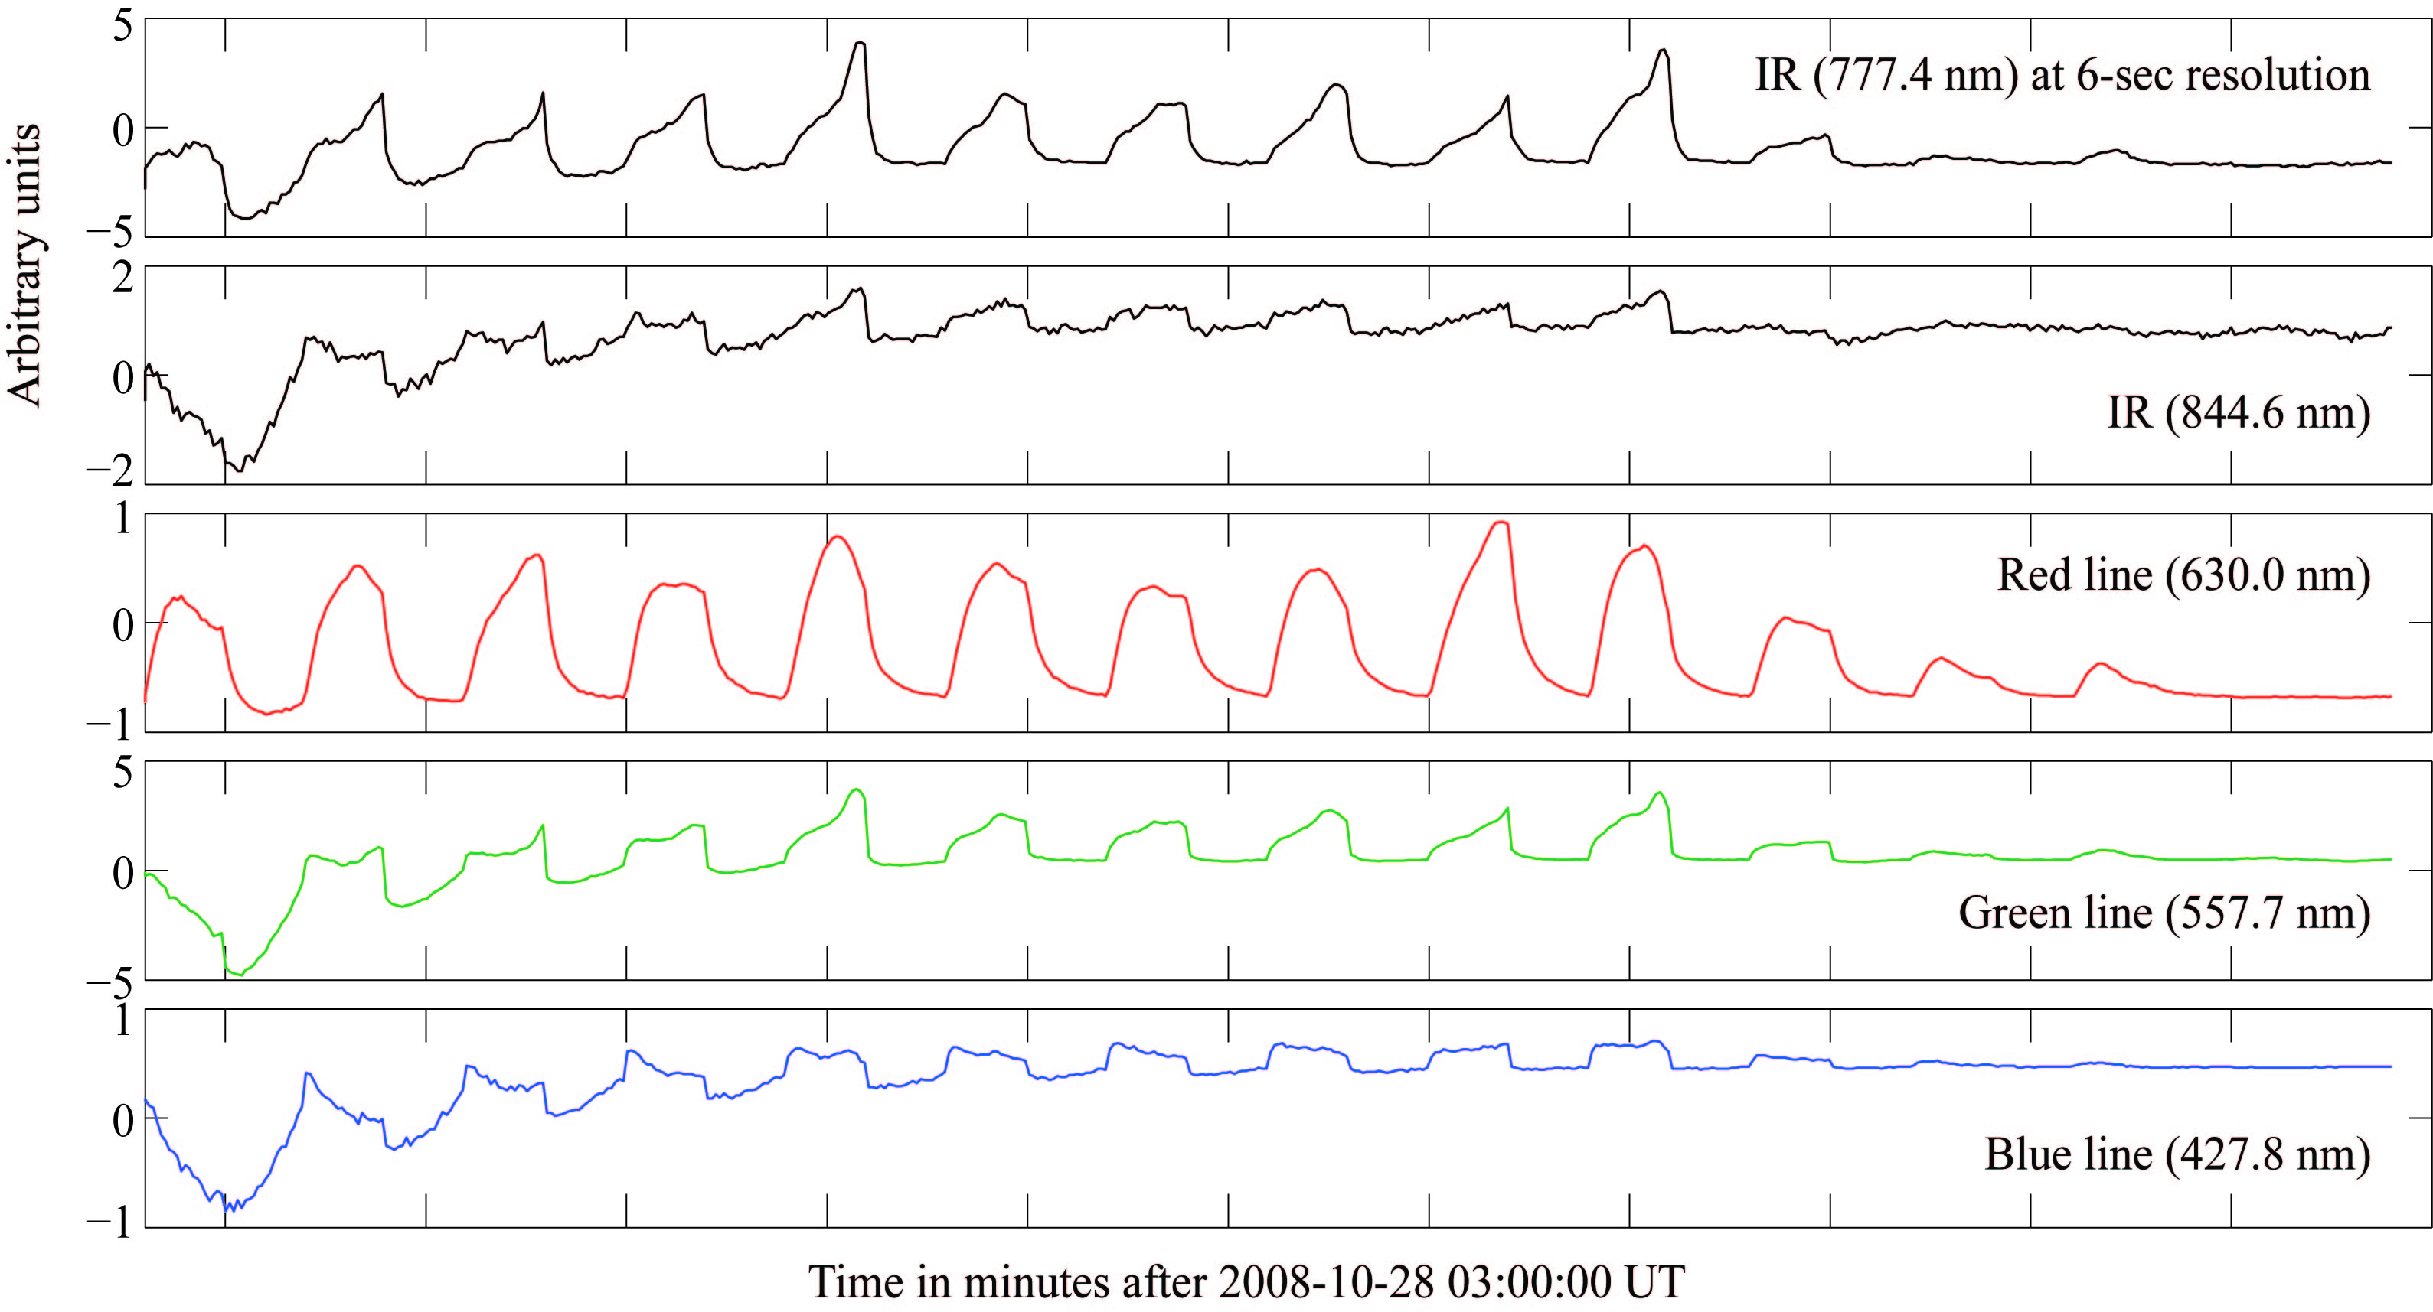
Telescopically-imaged heater-induced airglow
Stanford/HAARP Photometer

Slide 20
Formation of the ionized layers

Slide 21
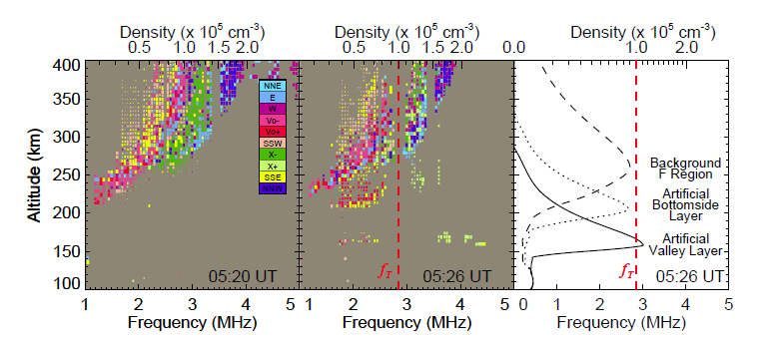
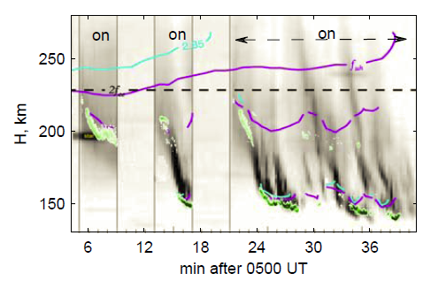
Descending AA
2GH, 440 MW, MZ
(left) Background echoes (the heater off).
(center) Heater on: Two lower layers of echoes near 160 and 200 km virtual height for 210 s.
(right) True height profiles.
Time-vs-altitude plot of 557.7 nm optical emissions along B with contours showing the altitudes where fp =2.85 MHz (blue), UHR= 2.85 MHz (violet), and 2f_{ce} = 2.85 MHz (dashed white). Horizontal blips are stars. Shown in green is the Ion Acoustic Line intensity.
the artificial plasma near h_{min} was quenched several times.
Pedersen et al., GRL 2010
Mishin & Pedersen , GRL 2011

Slide 22
Modeling the ionization wave
The ionization wave occurs in steps, the descending suprathermal electrons ionize the neutral species till the plasma reaches such density that it reflects the HF wave. The reflected wave generates the Langmuir turbulence, leading to the electron acceleration.
A 1D model of a uniform plasma slabs is applied:
The ionization is caused by descending flux of suprathermal electrons (energy losses included)
E-I recombination, charge exchange and ambipolar diffusion all take place inside a slab

Slide 23
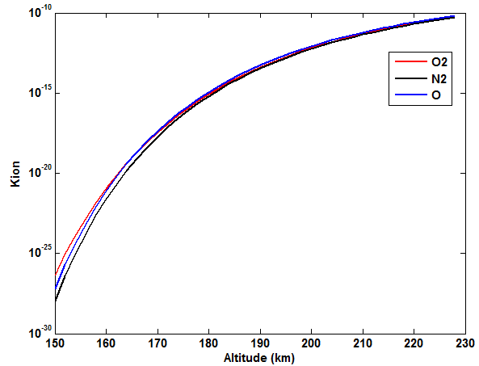
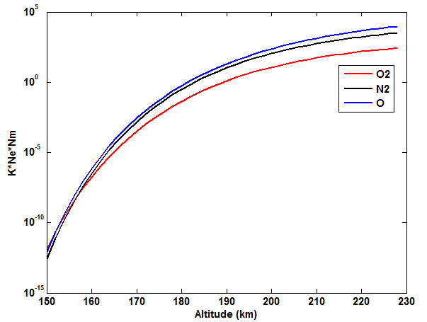
Eo= 0.6 eV, E in= 1.5 V/m
K_{ion}
K_{ion}*N_{m}*N_{e0}

Slide 24
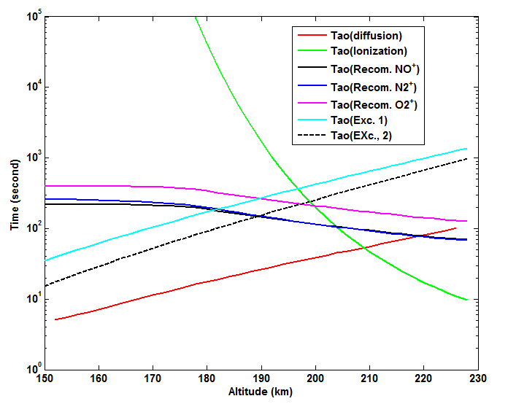
Timescales at 216 km

Slide 25
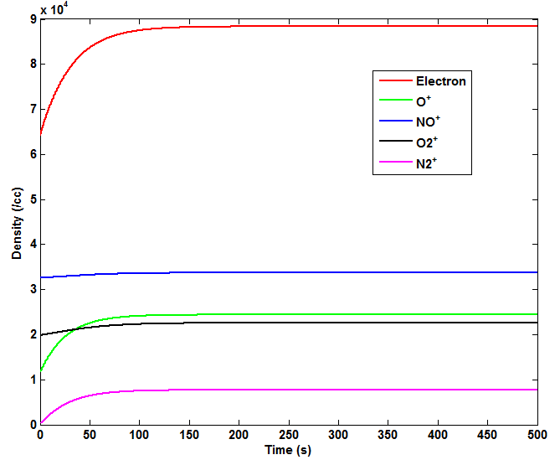
Electron and ion density evolution at 200 km

Slide 26
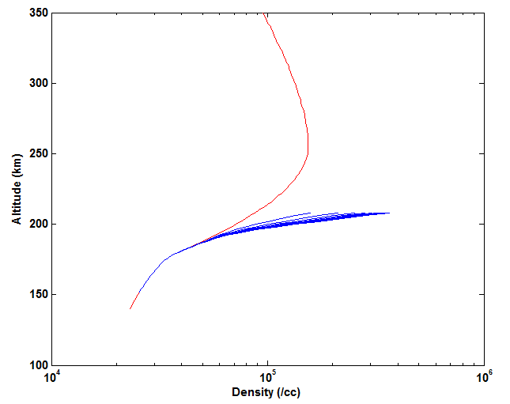
Electron Density Profile
Heating layer moved to z= 216 km
10 second each

Slide 27
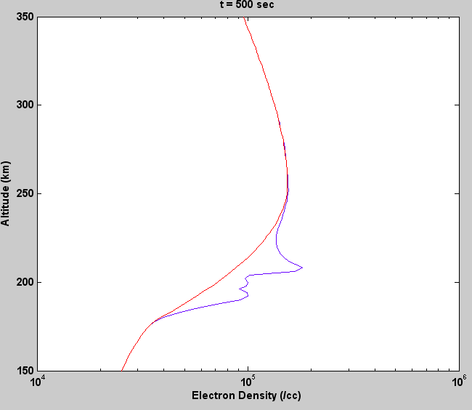
Additional slides

Slide 28
Conclusions
A model of artificial optical emissions and formation of the ionized layers is discussed
The model is based of the electron acceleration by the Langmuir turbulence caused by HF-heating
The ionization wave which forms the ionized layers occurs in steps
The model will be checked against the existing observations

