Slide 1
Physics of the Geospace Response to Powerful HF Radio Waves
HAARP-Resonance Workshop, 8-9 November 2011
Evgeny Mishin
Space Vehicles Directorate
Air Force Research Laboratory
Acknowledgments: Chin Lin, Todd Pedersen of AFRL and Gennady Milikh of UMD

Slide 2
OUTLINE
Introduction
HF-driven plasma instabilities
Descending artificial plasma layers: Electron acceleration
Ionizing wave
Density ducts and ion outflows: Deficiency of heating
Notes:
The dynamics of the ionosphere under the impact of powerful high frequency (HF) electromagnetic waves, including HF-driven instabilities and nonlinear processes that transfer the HF energy to plasma waves and observations of artificial aurora (AA) and stimulated electrostatic and electromagnetic emissions (SEE) during heating experiments at the HAARP and EISCAT heating facilities.

Slide 3

Cartoon of Artificial Aurora
B
F region
Natural Aurora
Ring-like Structure
630.0
SEE
Moon
AA
Magnetic Zenith Spot
557.7 nm
On-site Imager
Remote Imager
Ionosonde
HF Transmitter

Slide 4
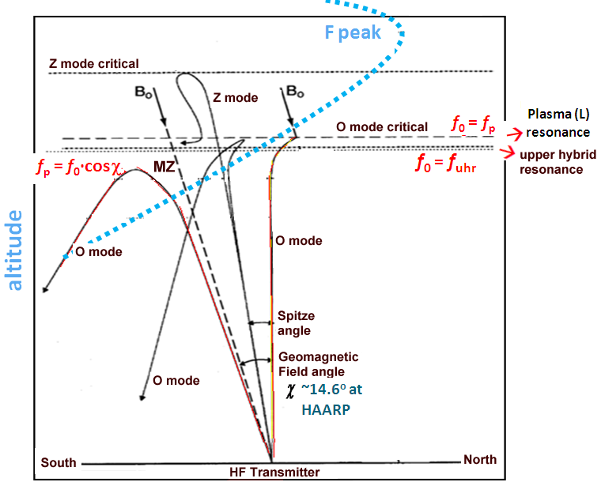
HF Heating
Energy Conversion
Electromagnetic
Waves
Electrostatic
Waves
Energetic
Electrons

Slide 5
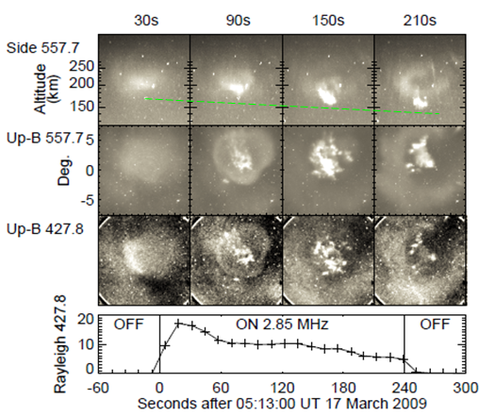
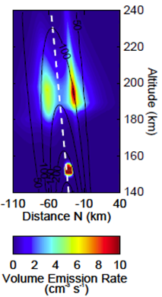
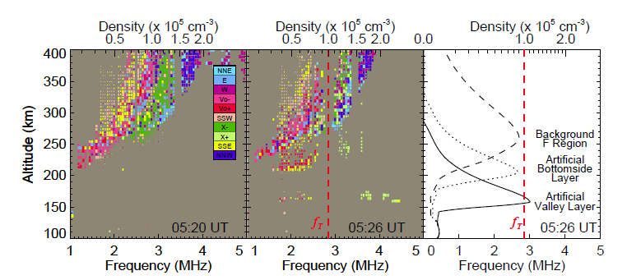
Descending ArtificialPlasma `Layer’
(left) Ionosonde background echoes (the heater off).
(center) Heater on: Two lower layers of echoes near 160 and 200 km virtual height for 210 s.
(right) True height profiles.
1-sec Images of AA from: (top) the remote site at 557.7-nm and the HAARP site looking up along B at 557.7-nm (2nd row) and 427.8 nm (3rd row).
4th row: Average intensities at 427.8 nm for the images’ center
A tomographic reconstruction of the cross-section of the 557.7-nm volume emission rate for 210 s
Pedersen et al., GRL 2010

Slide 6
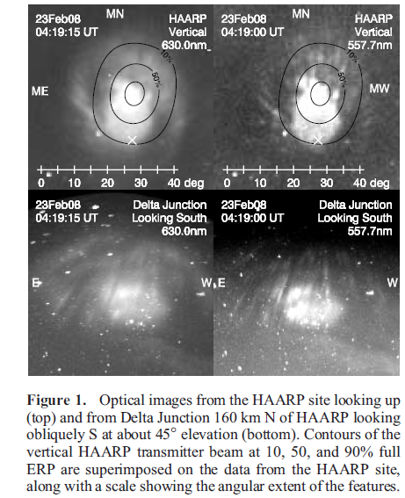
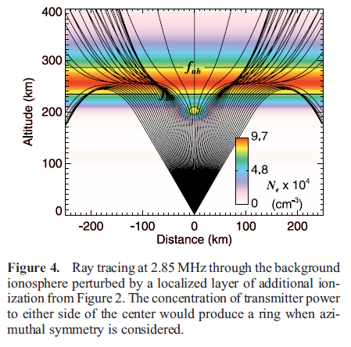
Optical Ring
Pedersen et al., GRL 2010

Slide 7
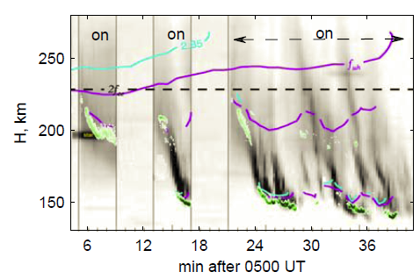
Descending Ionizing Wavefront
Three potential mechanisms :
  1) suppression of recombination by electron temperature increases
  2) thermal redistribution of plasma by the electron pressure bulge
  3) ionization by suprathermal electrons.
The observed strong optical emissions at 557.7, 777.4, and 427.8 nm are most consistent with (3)
Time-vs-altitude plot of 557.7 nm optical emissions along B with contours showing the altitudes where fp =2.85 MHz (blue), UHR= 2.85 MHz (violet), and 2f_{ce} = 2.85 MHz (dashed white). Horizontal blips are stars.
Ion Acoustic Line backscatter is shown in green. Red dashed lines indicate Ionizing Wavefronts during heater-on periods (NB: Repeatable self-quenching).
Mishin & Pedersen , GRL 2011

Slide 8

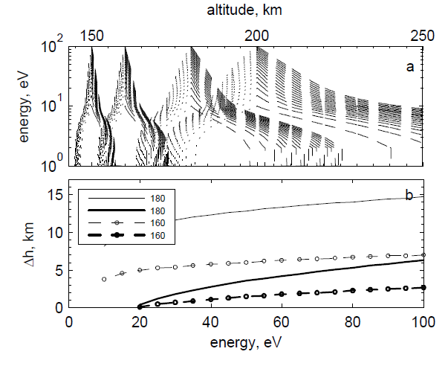

Accelerated Electrons & Ionization
Near 180 km the plasma frequency in the descending layer reaches f₀ or n_{e}=n_{c} blocking propagation of the HF beam above the artificial layer. The artificial plasma is now completely self-sustained and rapidly propagates along the magnetic field downward as the ionizing wave front due to ionization by accelerated electrons.
(a) Altitude profi les ε(ε₀,h) at ε₀ =10, 15, ...100 eV and h₀ =150, ...200 km. (b) Half-widths Δ_{g} (thin lines) and Δ_{b} (thick) of the green- and blue-line excitation layers near h_{c} =160 (circles) and 180 (solid lines) km.
Mishin & Pedersen, GRL 2011

Slide 9








Ionizing Wave
At each time step artificial ionization occurs near the altitude h_{c}, where n_{e}=n_{c} . The density profile just below h_{c} is represented as
Distance along B
Average ionization length
Ionization by accelerated (subscript a) electrons increases the plasma density near h_{c}
Ionization time
Speed of descent
In excellent agreement with the optical observations

Slide 10
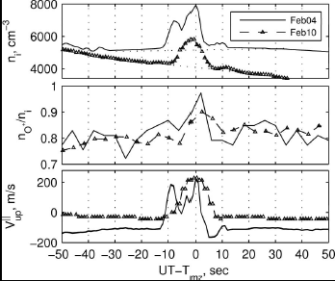
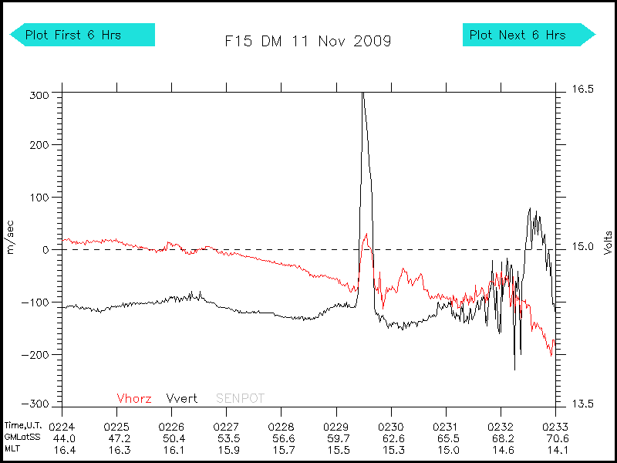
Ducts and Ion Outflows
Density ducts
O⁺/n_{e} ratio
Ion vertical velocity
Observed during the period of descending APLs
Milikh et al., GRL, 2010
Notes:
10

Slide 11
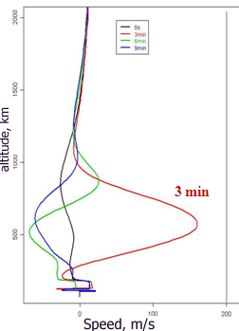
Simulations
SAMI2
FLIP
4 min heating
at 4000 K/ s
Before heating (t = 0) ions drift downward at < 20 m/s.
During heating (t= 3 min) ions drift upward at altitudes from 300 km to 1000 km and reach 160 m/s at 600 km.
After heating (t = 6 min) ions drift downward below 800 km and upward at higher altitudes
After cooling (t = 9 min) ions move downward
2-min steps.
Two experimental values on the left are from ionosonde skymaps and that on the right is from DMSP F15.
Match after 6 min in the strongest heating.
Milikh et al., GRL, 2010
11
Notes:
11

Slide 12
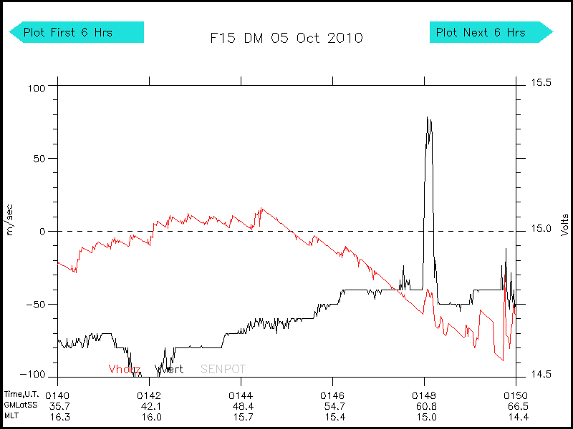
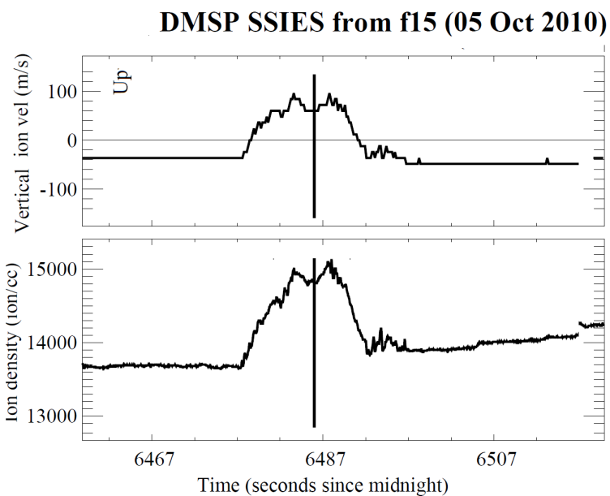
Simulation vs. observations
Contradicts to the conventional fluid models
Requires that heat transfer or/and suprathermal effects be accounted for.
Observed in only 3 min in the heating → 3 km/s upward propagation speed
12
Notes:
12

Slide 13
Summary
The HF-driven ionization process is initiated near 220 km altitude in the ambient F layer. Once the artificial plasma reaches sufficient density to support interaction with the transmitter beam it rapidly descends as an ionization wave to ~150 km altitude. Ionizing wave model due to HF-accelerated electrons explains the observations.
2-3 km/s speeds needed to explain the fast appearance of artificial ducts and ion outflows in the topside ionosphere contradict to the conventional (fluid) models.
Point to suprathermal populations and/or heat transfer processes.

Slide 14
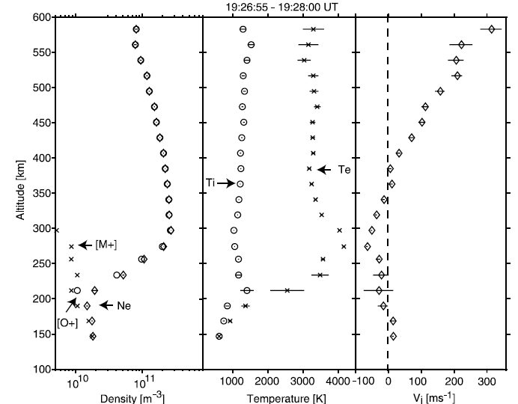
EISCAT UHF radar observations
T_{e}
MZ
N_{e}
V_{i}

